Slide 1
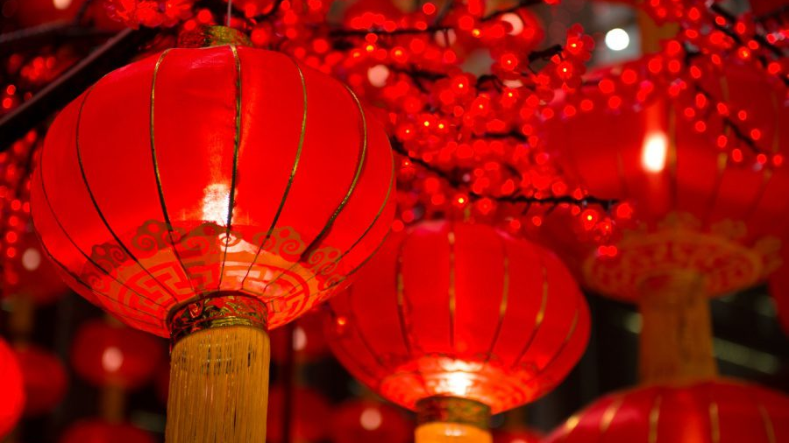
Chinese New Year
By Mary

Slide 2
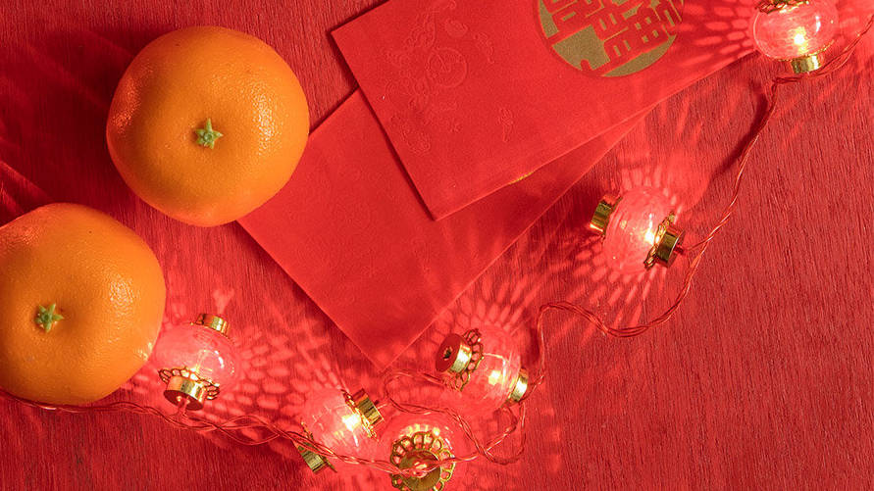
Traditions
Celebrations to usher out the old year and bring forth the luck and prosperity of the new one, therefore, often include firecrackers, fireworks, and red clothes and decorations are used. Young people are given money in colourful red envelopes. In addition, Chinese New Year is a time to feast and to visit family members. Today it's celebrated also by Chinese communities outside the country. Lion dance, dragon dance, temple fairs, flower market shopping and so on are just a few of these rich and colourful activities.

Slide 3
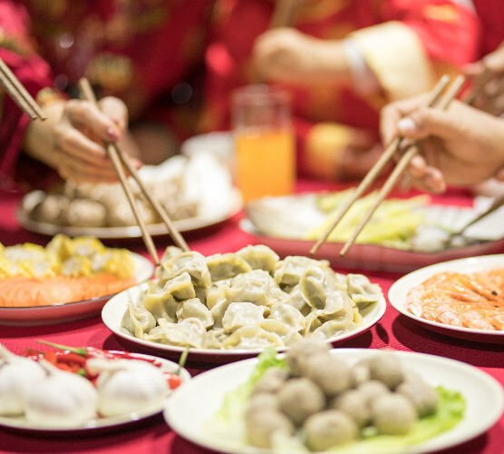
Food
There is a lot of food eaten on Chinese New Year.
On Chinese New Year you may find people eating dumplings, noodles, fish, spring rolls, tangerines, oranges, sweet rice balls, fresh fruit and lots more.

Slide 4
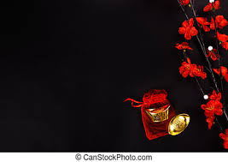
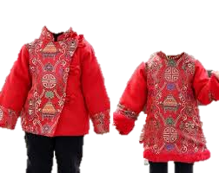
What They Wear
Chinese usually wear red or other brightly-coloured clothes on New Year's Day, to go to the festive and upbeat mood.
Red is China's good luck colour, believed to scare away spirits of bad fortune.
Some families wear traditional Chinese clothing like qipao or Tangzhuang.

Slide 5
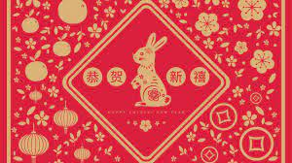
The Rabbit
On January 22nd 2023, the Chinese New Year of the Rabbit bounds into action.
All Rabbit years are believed to bring happiness and good luck, but this is no ordinary Rabbit year, for 2023 is the year of the Black Water Rabbit - a specially gifted, creative Rabbit that has not been seen since 1963.

Slide 6
Fun Facts
Chinese New Year is also called "Spring Festival“.
It is a festival for 1/4 of the world's population.
The Chinese New Year date changes each year.
Every Chinese New Year starts a new animal's zodiac year.

