Slide 1
Chinese New Year
BY AVA

Slide 2
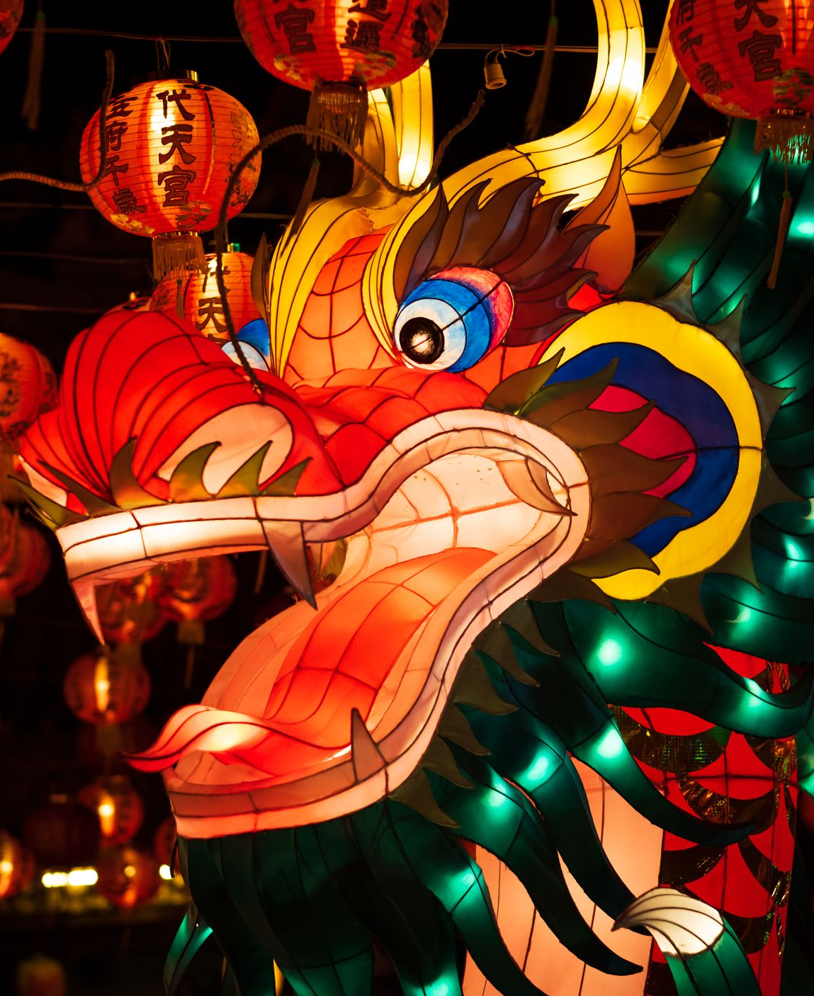
Traditions
putting up decorations,
offering sacrifices to ancestors,
eating reunion dinner with family on New Year's Eve,
giving red envelopes and other gifts,
firecrackers and fireworks, and.
watching lion and dragon dances.

Slide 3
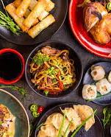
Meals
Traditional Lunar New Year foods include longevity noodles, a whole steamed fish for abundance, sticky rice balls for togetherness, and more. You'll find some of those lucky foods, along with other traditional dishes like dumplings and rice cakes.

Slide 4
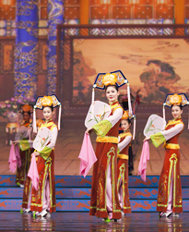
Chinese dances
Dance in China is a highly varied art form, consisting of many modern and traditional dance genres. The dances cover a wide range, from folk dances to performances in opera and ballet, and may be used in public celebrations, rituals and ceremonies.

Slide 5
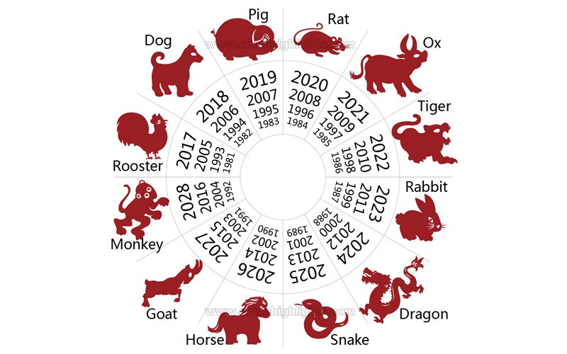
Animals
There are 12 Chinese zodiac signs, in the following order: Rat, Ox, Tiger, Rabbit, Dragon, Snake, Horse, Goat, Monkey, Rooster, Dog, and Pig. Each sign is named after an animal, and each animal has its own unique characteristics.

Slide 6
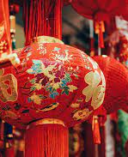
The lanterns
The Chinese New Year holiday comes to its climax with the Yuan Xiao (元宵节 / yuán xiāo jié), or Lantern Festival, celebrated on February 5th, 2023. Began over 2000 years ago, the festival has developed many meanings. It celebrates family reunions and society. It features ancient spiritual traditions.

Slide 7
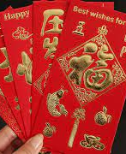
Red envelope
During this special cultural celebration, it's very common for Chinese people to give the gift of a red envelope (known as 紅包, hóngbāo) to friends and family. These long, narrow envelopes are filled with money and symbolize good wishes and luck for the new year ahead.8 Sept 2022During this special cultural celebration, it's very common for Chinese people to give the gift of a red envelope (known as 紅包, hóngbāo) to friends and family. These long, narrow envelopes are filled with money and symbolize good wishes and luck for the new year ahead.

